Slide 1
Why Does My Computer Do That? Intro to Coding with Python– Intro to Python
Dr. Ab Mosca (they/them)
Slides based off slides courtesy of Jordan Crouser (https://jcrouser.github.io/)

Slide 2
Plan for Today
Intro to Python programming language
Intro to pair programming
Intro to repl.it

Slide 3
Recap
What do you remember
from Friday’s class?

Slide 4
Recap: the good news
“High level” programming languages like Python mean we don’t have to write in “low level” binary
Instead, we write statements like:
print(“hello”)
Notes:
However, it’s useful to understand that for all the things we ask of our machines at a high level, at this level (show hardware), everything we do is just operations on 0s and 1s.

Slide 5
multi-paradigm
interpreted language
with dynamic typing
and automatic memory management

Slide 6
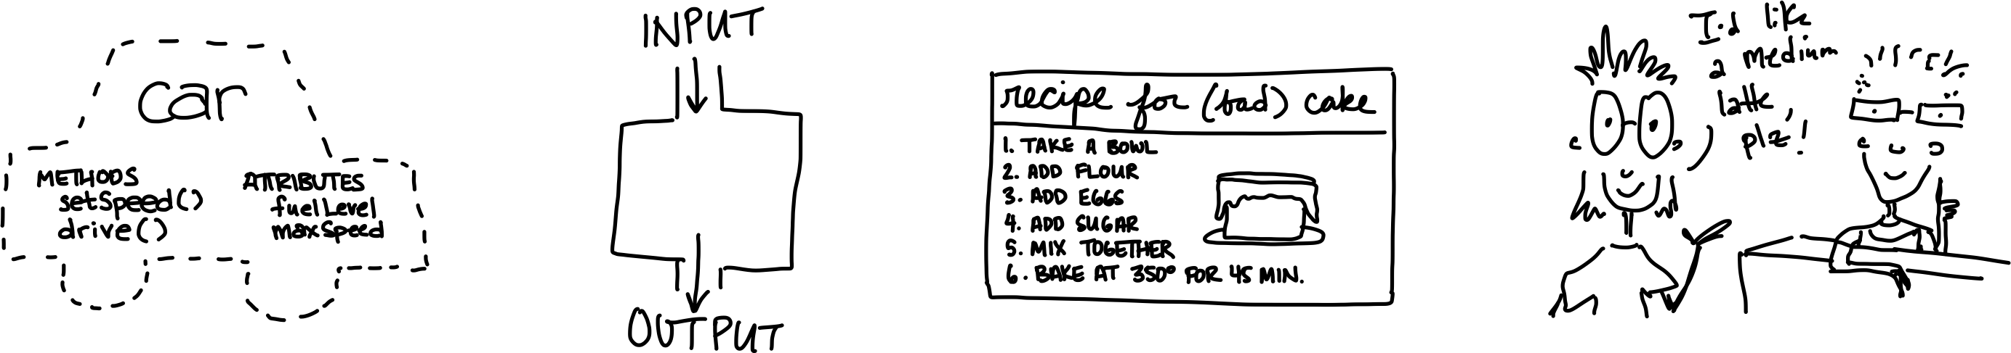
multi-paradigm
interpreted language
with dynamic typing
and automatic memory management
object-oriented
functional
imperative
declarative
Notes:
Object oriented
This type of language treats a program as a group of objects composed of data and program elements, known as attributes and methods.
Functional
Rather than focusing on the execution of statements, functional languages focus on the output of mathematical functions and evaluations. Each function–a reusable module of code–performs a specific task and returns a result.
Imperative
In computer science, imperative programming is a programming paradigm of software that uses statements that change a program's state. In much the same way that the imperative mood in natural languages expresses commands, an imperative program consists of commands for the computer to perform. Imperative programming focuses on describing how a program operates step by step,^{[1]} rather than on high-level descriptions of its expected results.
Declarative
In computer science, declarative programming is a programming paradigm—a style of building the structure and elements of computer programs—that expresses the logic of a computation without describing its control flow.
Ex. SQL, regex

Slide 7
multi-paradigm
interpreted language
with dynamic typing
and automatic memory management

Slide 8
Quick digression
 | COMPILER | INTERPRETER
What it takes in:
What it returns:
Relative speed:
Memory usage:
Work is done:
Reports errors:
Example language:
Notes:
With interpreted languages, code goes through a program called an interpreter, which reads and executes the code line by line. This tends to make these languages more flexible and platform independent.
Compiled languages go through a build step where the entire program is converted into machine code. This makes it faster to execute, but it also means that you have to compile or "build" the program again anytime you need to make a change.

Slide 9
multi-paradigm
interpreted language
with dynamic typing
and automatic memory management
more about this
a bit later

Slide 10
Core Concepts to Get Us Started

Slide 11
Pair Programming

Slide 12
The programming process

Slide 13
The programming process (idealized)

Slide 14
The programming process (idealized)

Slide 15
The programming process (idealized)

Slide 16
The programming process (idealized)

Slide 17
The programming process (idealized)

Slide 18
The programming process (more realistic)

Slide 19
Getting started

Slide 20
“S⁴”: start small | slow | simple

Slide 21
Next: address the constraints

Slide 22
Add additional features

Slide 23
Finally: hit target

Slide 24
A problematic (but common) model

Slide 25
A better model: “pair programming”
two
people
one
machine

Slide 26
Two complimentary roles
driver
navigator

Slide 27
A common analogy
driver
navigator

Slide 28
Navigator vs. driver: different focus
“what”
“how”
“why”

Slide 29
Info & Storage

Slide 30
Storage
Want to store this important information for later:
3

Slide 31
Storage
Want to store this important information for later:
3
Hard Disk
RAM

Slide 32
Storage
Want to store this important information for later:
3
RAM
Zone H
Zone G
Zone F
Zone E
Zone D
Zone C
Zone B
Zone A

Slide 33
Storage
Want to store this important information for later:
RAM
Zone H
Zone G
Zone F
3
Zone E
Zone D
Zone C
Zone B
Zone A

Slide 34
Storage
Want to store this important information for later:
RAM
3
Zone C, Column 5, Row 40

Slide 35
Storage
Want the CPU to double the important information
3
Zone C, Column 5, Row 40

Slide 36
Storage
Want the CPU to double the important information
We need to tell it where to look
double “important information” at “Zone C, Column 5, Row 40”
3
Zone C, Column 5, Row 40

Slide 37
Storage
Want the CPU to double the important information
We need to tell it where to look
double “important information” at “Zone C, Column 5, Row 40”
3
Wordy
Refer to the same thing
Zone C, Column 5, Row 40

Slide 38
Storage
Want the CPU to double the important information
We need to tell it where to look
double “important information” at “Zone C, Column 5, Row 40”
3
Wordy
Refer to the same thing
Let’s use a shorthand
Zone C, Column 5, Row 40

Slide 39
Storage
Want the CPU to double the important information
We need to tell it where to look
double “important information” at “Zone C, Column 5, Row 40”
double x
3
Wordy
Refer to the same thing
Let’s use a shorthand
Zone C, Column 5, Row 40
Notes:
x tells the CPU where to look in. memory for info
x is our short hand for the information we want to manipulate

Slide 40
Storage
Want the CPU to double the important information
We need to tell it where to look
double “important information” at “Zone C, Column 5, Row 40”
double x
3
Wordy
Refer to the same thing
Let’s use a shorthand
Zone C, Column 5, Row 40
variable
Notes:
x tells the CPU where to look in. memory for info
x is our short hand for the information we want to manipulate

Slide 41
Core concept: variables
In CS, a variable is a place to store a piece of data
In Python, variables are:
declared by giving them a name
assigned using the equals sign
Example:
x = 3
declaring
a variable x
assigning
the value 3 to x

Slide 42
Core concept: numeric values
Two kinds of numbers in CS:
integers (“whole numbers”)
floats (“decimals” or “floating point numbers”)
In Python, the kind of number is implied by whether or not the number contains a decimal point
Example:
x = 3
x = 3.0

Slide 43
Core concept: strings
In CS, a sequence of characters that isn’t a number is called a string
In Python, a string is declared using quotation marks
Strings can contain letters, numbers, spaces, and special characters
Example:
x = “Jordan”
x = “Stoddard G2”

Slide 44
Core concept: print()
A function is a procedure / routine that takes in some input and does something with it (just like in math)
In Python, the print() function takes in a value and outputs the value to the console
This seems silly now, but will come in handy in lab when you write/run your first program inside a file

Slide 45
Coding Environment

Slide 46
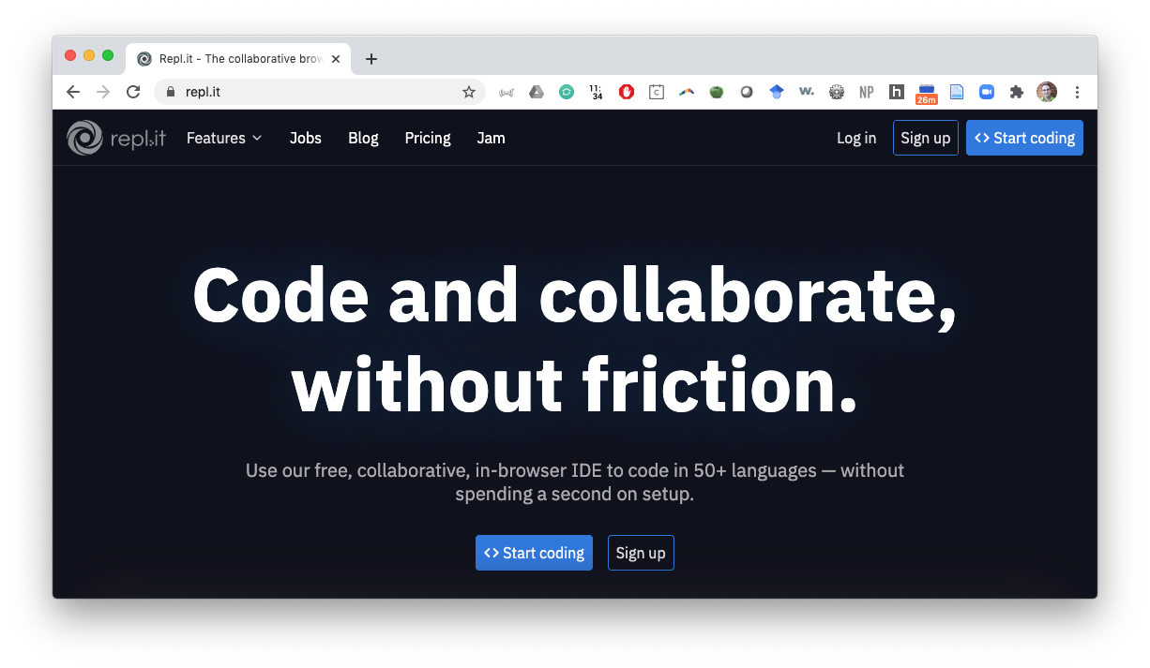
repl.it
Click to accept invite to this class: https://replit.com/teams/join/cbfzmzolnpzhbbarrspukzusuklzeihq-CAIS117-F23

